Slide 1
Machine Learning
Lab 1: Evaluation & Performance Measure
Dr. Shuang LIANG

Slide 2
Basic lab instructions
You may want to bring your slides to labs to look up syntax and examples.
Have a question? Ask a TA for help, or look at the lecture slides.
We encourage you to talk to your classmates; it's okay to share code and ideas during lab.
Make good use of these tools: search engines, API documentation and IDEs.
You don't have to finish all of the exercises. Just do as much as you can in the allotted time. You don't need to finish the rest after you leave the lab; there is no homework from lab.

Slide 3
Today’s lab exercises
The exercise consists of two parts, Evaluation and Performance Measure
In the Evaluation part, you will complete the following exercises using the existing model (task 2 is optional)
1.Use n-times K-fold cross validation to find the best model
2.Use hold-out and bootstrapping method validation to find the best model
In the Performance Measure part, you will complete the following exercises using the above experimental results(task 2、3 is optional)
1.Draw PR and ROC map of the best model
2.Draw PR and ROC maps of all models
3.Compare and analyze them

Slide 4
Part 0 Project Description

Slide 5
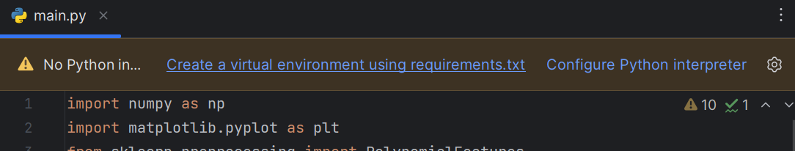
Experiment environment
Python 3.x
Libraries: Numpy & Matplotlib
Docs
Numpy：https://numpy.org/doc/stable/
Matplotlib：https://matplotlib.org/stable/tutorials/index.html
scikit-learn：https://scikit-learn.org/stable/index.html

Slide 6
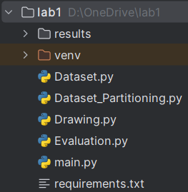
Project structure
main.py
Overall Process
Dataset.py
Dataset Generation
Dataset_Partitioning.py
Dataset Partitioning Method
Evaluation.py
Model Evaluation Method
Drawing.py
Drawing Method

Slide 7




Review: Framework
A set of function
Model
Training
Testing
“cat”
Goodness of function f
Pick the “Best” Function
Using
Training
Data
“monkey”
“cat”
“dog”

Slide 8
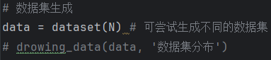
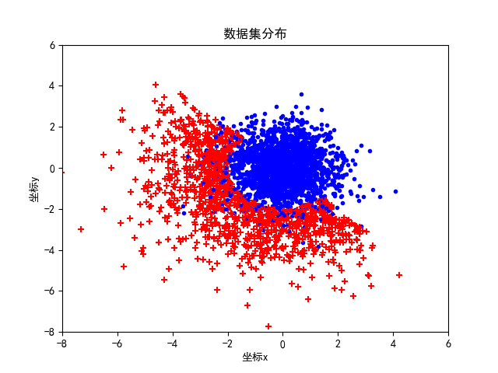
Preparing data
Dataset.py -- dataset(N)
Class 0 (Blue):
normal distribution for both x and y axes.
Class 1 (Red):
normal distribution for both x and y axes.
The "upper-right" part and the "center" part are excluded.
You can try to construct other styles of datasets on your own.

Slide 9
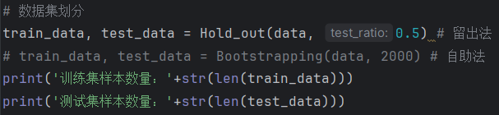
Preparing data
Here, the hold-out method is used to partition the dataset into training and testing sets. You can attempt to implement the bootstrap method for dataset partitioning.
Observe the format of the dataset on your own.

Slide 10
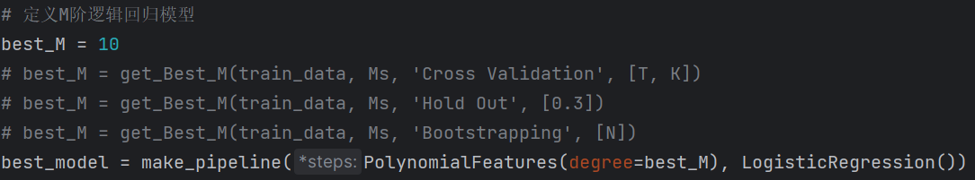
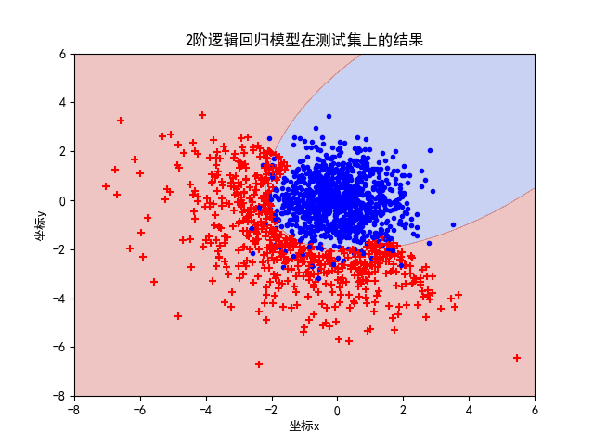
Model
M-order logistic regression classifier, geometrically speaking, seeks an M-order decision boundary curve in the sample space.
Here, please utilize different evaluation methods to find the best M among Ms.

Slide 11
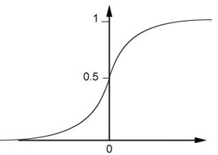
Model
Model Output:
For example, a 1st-order logistic regression classifier:
1 / (1 + np.exp(- (w0 + w1 * x+ w2 * y)))
The results are taken from 0 to 1. You can choose a threshold value, such that data from 0 to the threshold is classified as "0", and from the threshold to 1 is classified as "1".

Slide 12
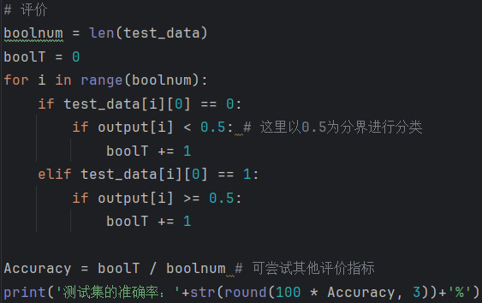
Test Result
As mentioned earlier, the threshold here is set to 0.5, and "accuracy" is used as the evaluation metric.
You can also try other evaluation metrics such as precision, recall, true positives, false positive rate, etc.

Slide 13
Part 1 Evaluation

Slide 14
Review: K-fold Cross Validation
Training Set
Model 1
Model 2
Model 3
Train
Train
Val
Err = 0.2
Err = 0.4
Err = 0.4
Train
Val
Train
Err = 0.4
Err = 0.5
Err = 0.5
Val
Train
Train
Err = 0.3
Err = 0.6
Err = 0.3
Avg Err
= 0.3
Avg Err
= 0.5
Avg Err
= 0.4
Testing Set
Testing Set
(real)

Slide 15
Review: Hold-out 留出法
When dividing the data set, try to ensure the consistency of data distribution as much as possible!
分层采样：保留类别比例
If
D contains 500 positive samples, 500 negative samples
D
1000 Samples
Then
S: 350 positive samples, 350 negative samples
T: 150 positive samples, 150 negative samples
S
700 Samples
T
300 Samples

Slide 16
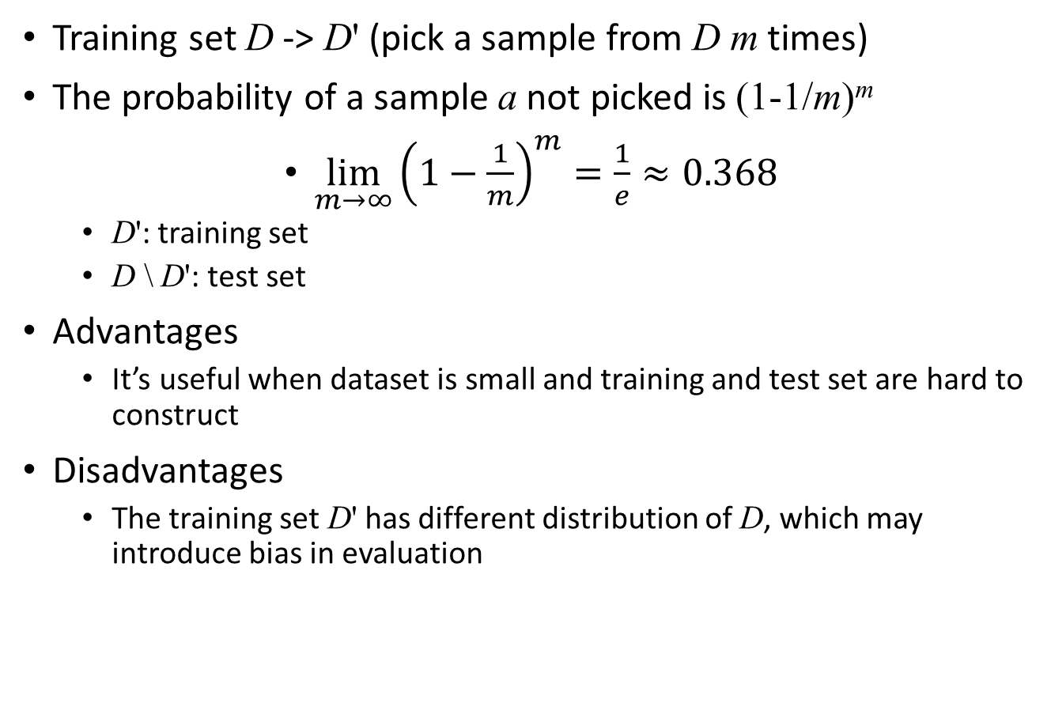
Review: Bootstrapping 自助法
Training set D -> D' (pick a sample from D m times)
The probability of a sample a not picked is (1-1/m)^{m}
$\lim_{m→∞}{{\left(1−\frac{1}{m}\right)}^{m}}=\frac{1}{e}≈0.368$
D': training set
D \ D': test set
Advantages
It’s useful when dataset is small and training and test set are hard to construct
Disadvantages
The training set D' has different distribution of D, which may introduce bias in evaluation
Notes:
数据集有m个样本
拿出后允许放回
自助法的本质优势？
优点：自助法在数据集较小、难以有效划分训练/测试集时很有用；自助法能从初始数据集中产生多个不同的训练集，这对集成学习等方法有很大的好处。
缺点：自助法产生的数据集改变了初始数据集的分布，这会引入估计偏差。 算法的参数，也称为超参数。
对于小数据集，bootstrap效果通常很好。然而，bootstrap产生的数据集改变了初始数据集的分布，这会引入估计偏差，随着数据集总体的增加而功效降低。尽管可以在Bootstrap过程中调整偏差，但情况就会变得复杂。因此普遍认为原数据集的总体不能过大，这样可以保证每次抽样都能反映总体的特性，多次抽样后即能覆盖原总体，并且抽样组成的新总体比原总体大。
总体均值不连续时也要慎重考虑使用bootstrap。

Slide 17
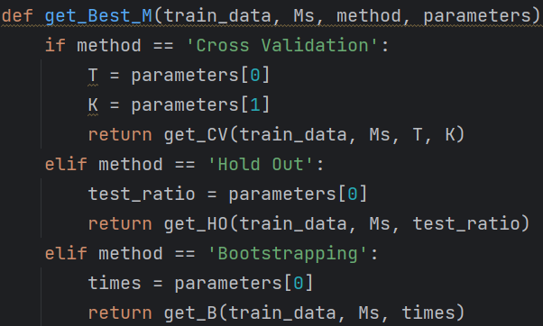
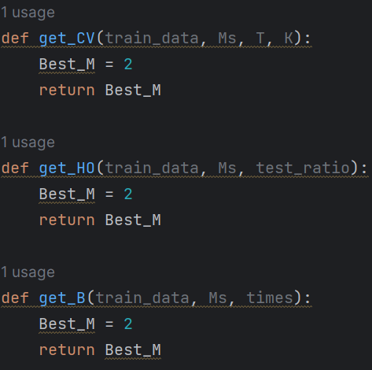
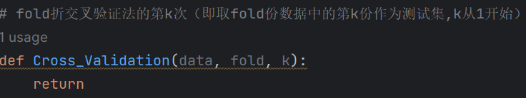
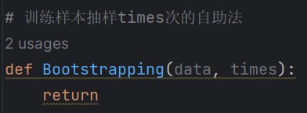
Tasks (45mins)
Please finish them in Evaluation.py and Dataset_Partitioning.py

Slide 18
Tasks (45mins)
In the Evaluation part, you will complete the following exercises using the existing model
Basic Tasks：
Complete the validation set partition process of K-fold cross validation in Dataset_Partitioning.py (15mins)
Complete n-times K-fold cross validation method in Evaluation.py to get the optimal model (15mins)
Extension Task：(You can do it after finish next part)
Complete hold-out and bootstrapping validation methods in Evaluation.py to get the optimal model (15mins)

Slide 19
Prompt
For each model:
For each cross-validation iteration:
For each fold in cross-validation:
1. Split the dataset into training and validation sets using Cross_Validation() in Dataset_Partitioning.py
2. Train the model.
3. Validate the model.
Compare the average accuracy of each model and determine the best model.

Slide 20
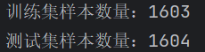
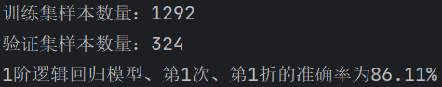
Expected result
for:
for:
for:
……
……

Slide 21
Part 2 Performance Measure

Slide 22
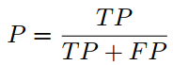
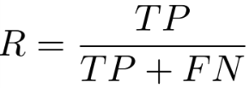
Review：Precision and Recall
Suitable for information retrieval, web search scenarios
A "confusion matrix" can be obtained by combining the statistics of the true labels and the predicted results
Ground truth | Predicted Result
 | True | False
True | TP | FN
False | FP | TN
Precision
Recall
Recall and precision are contradictory measures. Why?
Notes:
信息检索、Web搜索等场景中经常需要衡量正例被预测出来的比率或者预测出来的正例中正确的比率，此时查准率(Precision)和查全率(Recall)比错误率和精度更适合。

Slide 23
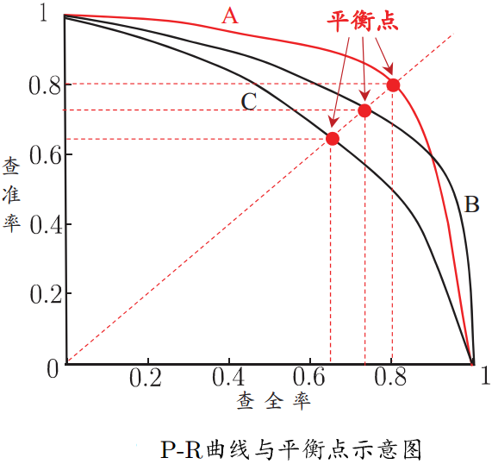
Review：Precision and Recall
According to the prediction results of the learner, the samples are sorted according to the probability of positive examples. If all samples are predicted as positive examples one by one, then the precision-recall curve, referred to as "P-R curve", can be obtained.
Break-even point
The value of “precision = recall” on the curve
Used to measure the performance of classifiers with crossed P-R curves.
Comprehensive consideration of recall and precision
Notes:
根据学习器的预测结果按正例可能性大小对样例进行排序，并逐个把样本作为正例进行预测，则可以得到查准率-查全率曲线，简称“P-R曲线”
平衡点是曲线上“查准率=查全率”时的取值，可用来用于度量P-R曲线有交叉的分类器性能高低

Slide 24
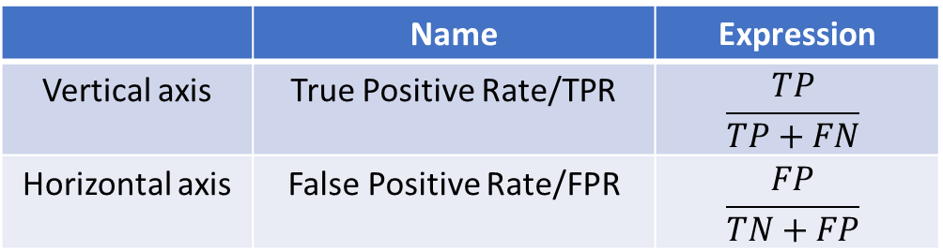
Review： ROC
Receiver Operating Characteristic(受试者工作特征)
The steps of sorting the samples and predicting the samples as positive examples are consistent with the PR curve
But the axes change
 | Name | Expression
Vertical axis | True Positive Rate/TPR | $$\frac{TP}{TP+FN}$$
Horizontal axis | False Positive Rate/FPR | $$\frac{FP}{TN+FP}$$
Ground truth | Predicted Result
 | True | False
True | TP | FN
False | FP | TN
Notes:
放在具体领域来理解上述两个指标。如在医学诊断中，判断有病的样本。那么尽量把有病的揪出来是主要任务，也就是第一个指标TPR，要越高越好。而把没病的样本误诊为有病的，也就是第二个指标FPR，要越低越好。不难发现，这两个指标之间是相互制约的。如果某个医生对于有病的症状比较敏感，稍微的小症状都判断为有病，那么他的第一个指标应该会很高，但是第二个指标也就相应地变高。最极端的情况下，他把所有的样本都看做有病，那么第一个指标达到1，第二个指标也为1。
我们可以看出：左上角的点（TPR=1，FPR=0），为完美分类，也就是这个医生医术高明，诊断全对；点A（TPR>FPR），医生A的判断大体是正确的。中线上的点B（TPR=FPR），也就是医生B全都是蒙的，蒙对一半，蒙错一半；下半平面的点C（TPR<FPR），这个医生说你有病，那么你很可能没有病，医生C的话我们要反着听，为真庸医。
上图中一个阈值，得到一个点。现在我们需要一个独立于阈值的评价指标来衡量这个医生的医术如何，也就是遍历所有的阈值，得到ROC曲线。还是一开始的那幅图，假设如下就是某个医生的诊断统计图，直线代表阈值。我们遍历所有的阈值，能够在ROC平面上得到如下的ROC曲线。

Slide 25
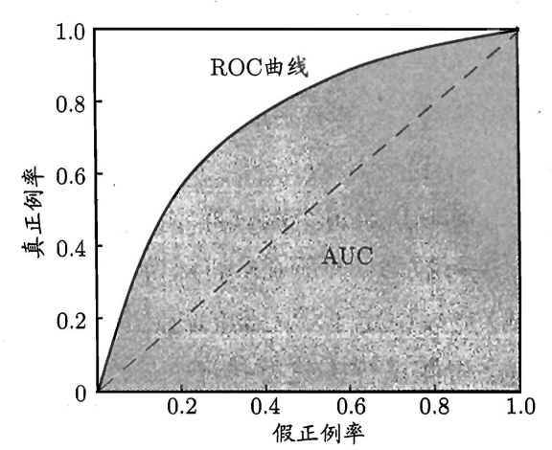
Review： ROC
阈值
Notes:
我们可以看出：左上角的点（TPR=1，FPR=0），为完美分类，也就是这个医生医术高明，诊断全对；点A（TPR>FPR），医生A的判断大体是正确的。中线上的点B（TPR=FPR），也就是医生B全都是蒙的，蒙对一半，蒙错一半；下半平面的点C（TPR<FPR），这个医生说你有病，那么你很可能没有病，医生C的话我们要反着听，为真庸医。
上图中一个阈值，得到一个点。现在我们需要一个独立于阈值的评价指标来衡量这个医生的医术如何，也就是遍历所有的阈值，得到ROC曲线。还是一开始的那幅图，假设如下就是某个医生的诊断统计图，直线代表阈值。我们遍历所有的阈值，能够在ROC平面上得到如下的ROC曲线。

Slide 26
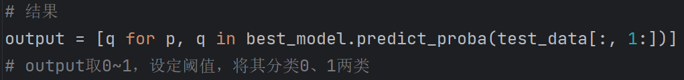
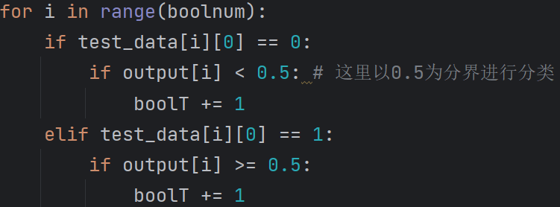
Preparing data
Observation data structure of ‘test_data’ and ‘output’
Analyze basic classification decisions：

Slide 27
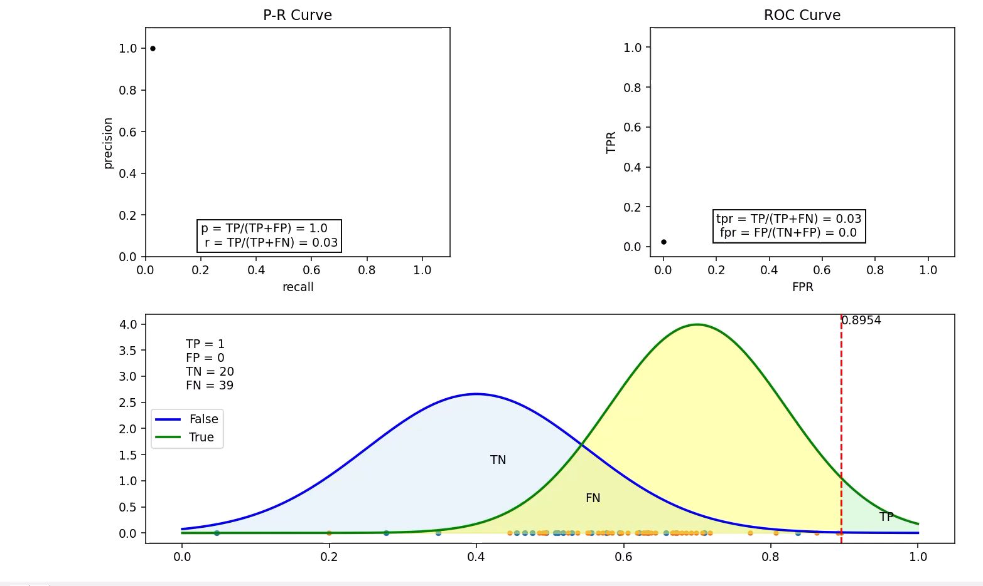
Prompt
The continuous decrease in the threshold will cause changes in the evaluation metrics.

Slide 28
Tasks (45mins)
In the Performance Measure part, you will complete the following exercises using the above experimental results
Basic Tasks：
1.Draw PR and ROC map of the best model (30mins)
Extension Task：
2.Draw PR and ROC maps of all models (15mins)
3.Compare and analyze them

Slide 29
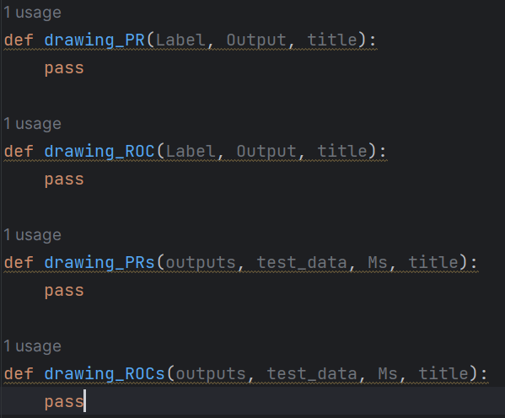
Tasks (45mins)
Please finish them in Drawing.py

Slide 30
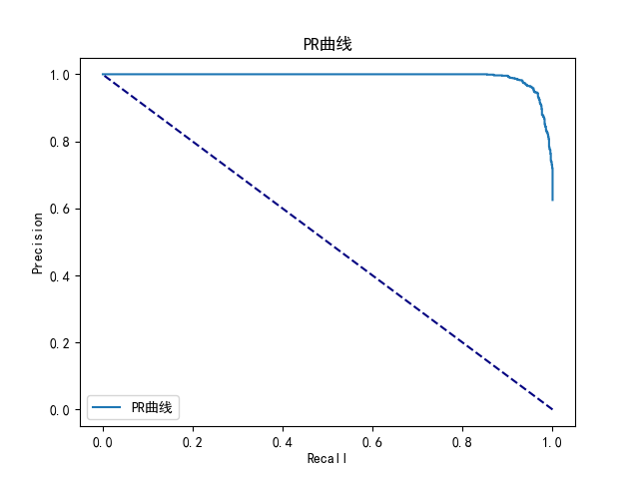
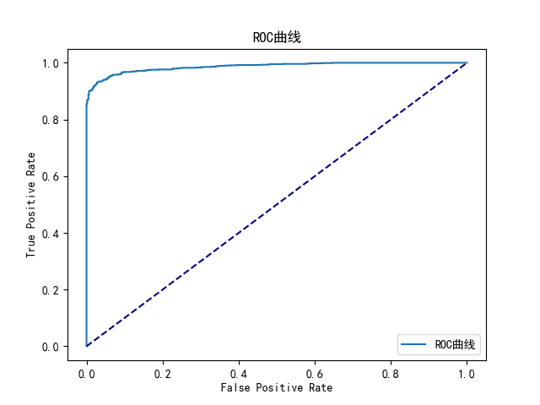
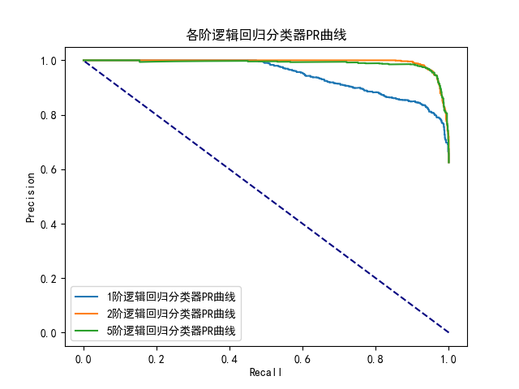
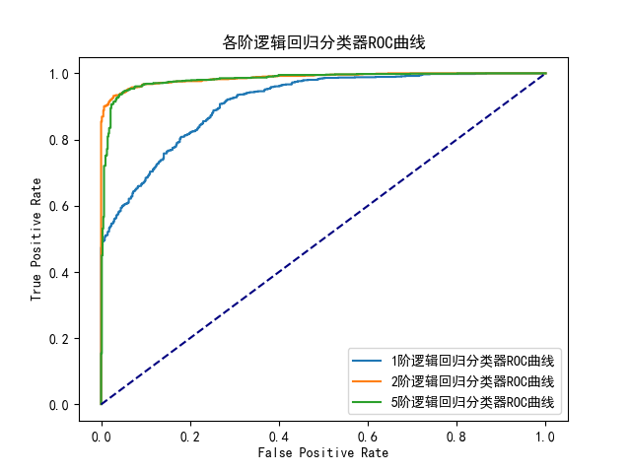
Expected result

Slide 31
Extension Task
If you have completed the above tasks, you can proceed to the following：
Part 1 Extension Task：
1.Complete hold-out and bootstrapping validation methods in Evaluation.py to get the optimal model
Part 2 Extension Task：
2.Draw PR and ROC maps of all models
3.Compare and analyze them
Notes:
We have to know where is the error come from?

Slide 32
Thank you for your attention!

